Slide 1



WHO Covid19 Analysis
View in Power BI
Last data refresh:
7/17/2020 3:43:07 PM UTC
Downloaded at:
7/17/2020 11:11:43 PM UTC

Slide 2
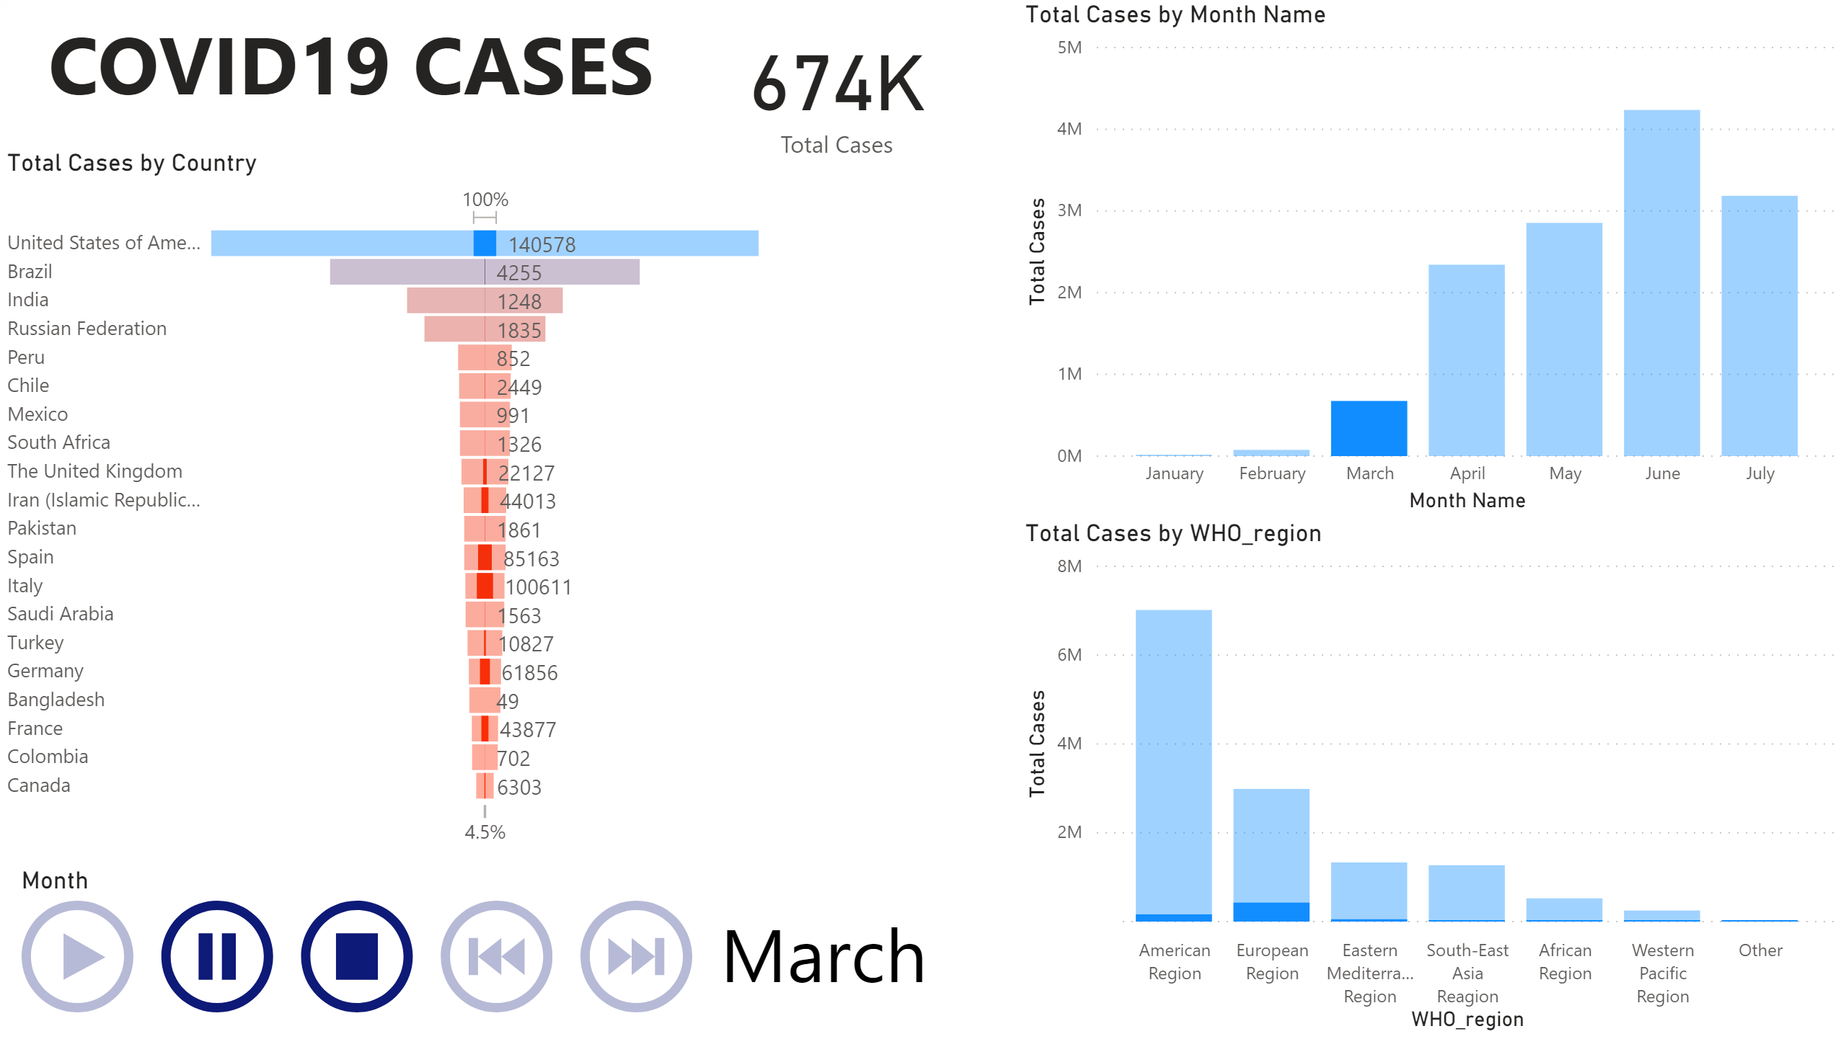

Slide 3
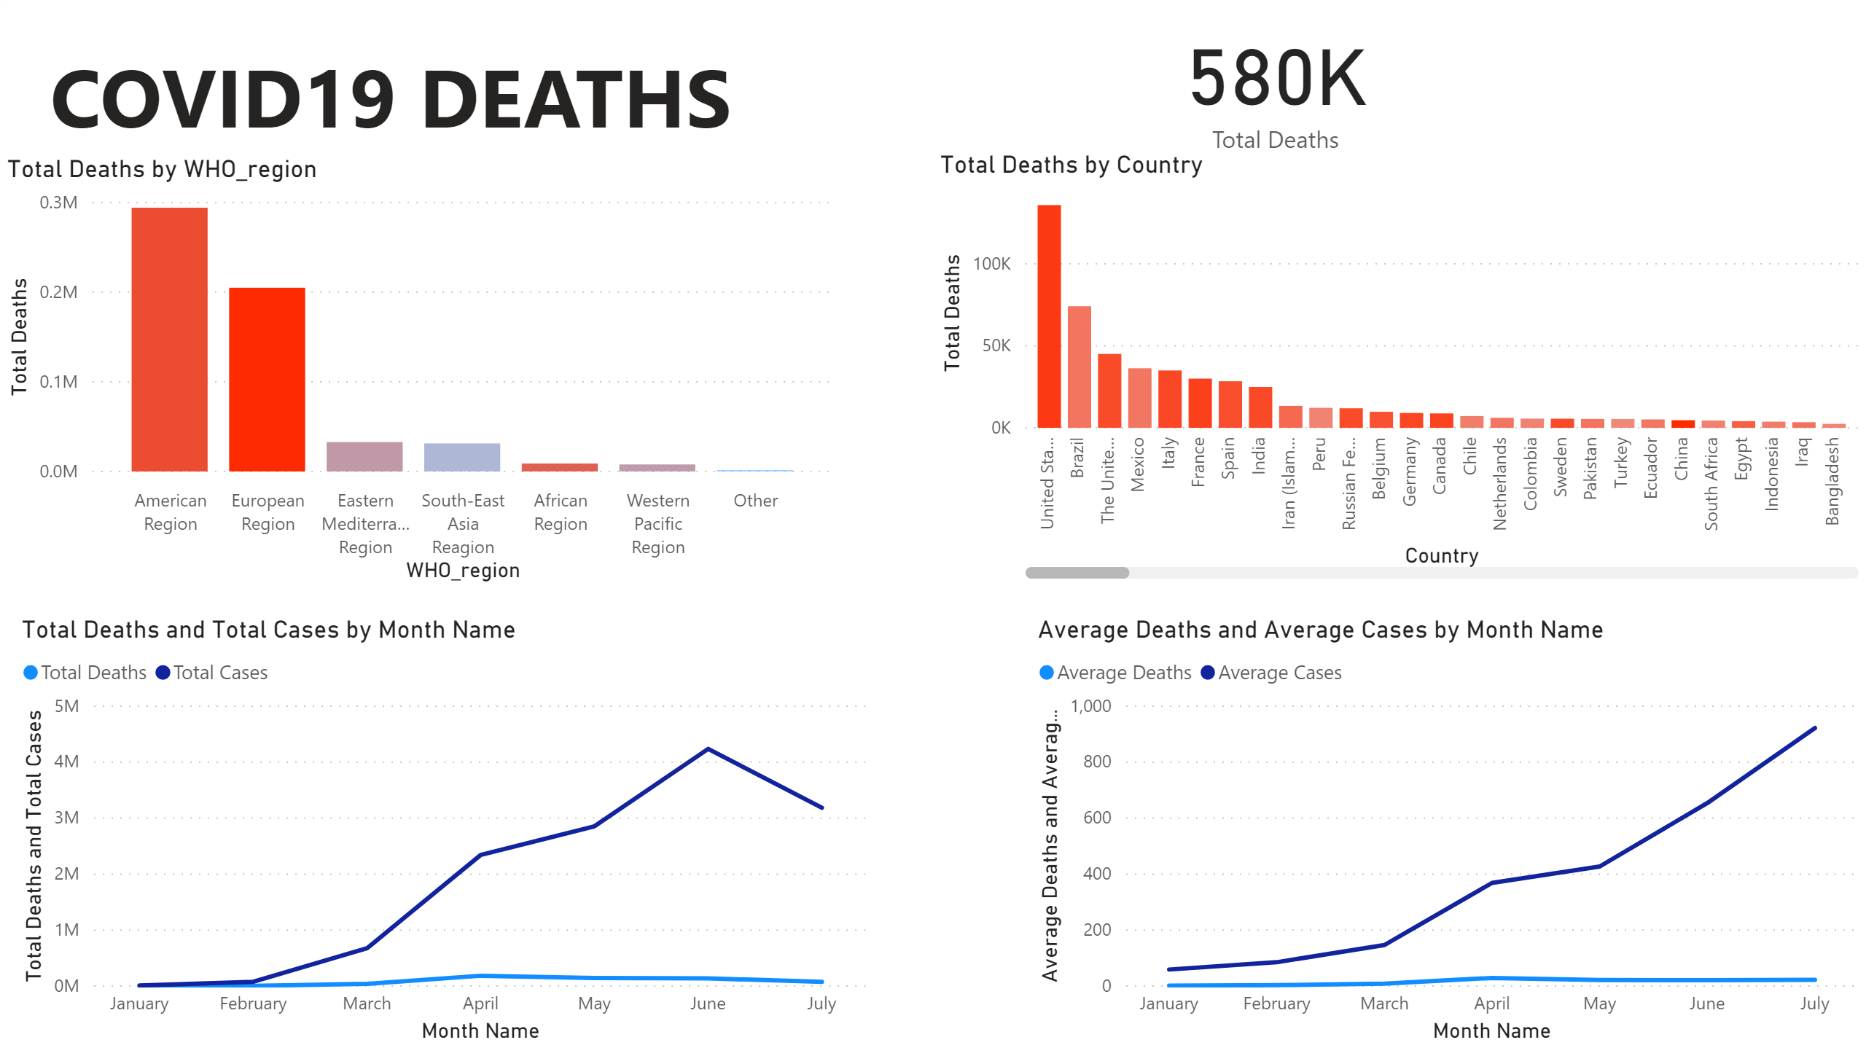

Slide 4
